Slide 1
Customer Conversion Prediction
Problem Statement
Problem statement is to build a ML model that predict if a client will subscribe to insurance or not.We need to uses the historical data to reduce the cost of telephonic marketing,still it effective but Incur lot of cost.It is also important to identify the customers that are most likely to convert beforehand so that they can be specifically targeted via call

Slide 2
Data Cleaning
Checked for null values but found no null values
Checked for duplicate values , we got some duplicate values and we removed them
Checked for data types but all the data types were found correct
Checked outliers by describe function and we got some outliers but we have imbalance data so we are not able to determine this is outliers or not

Slide 3
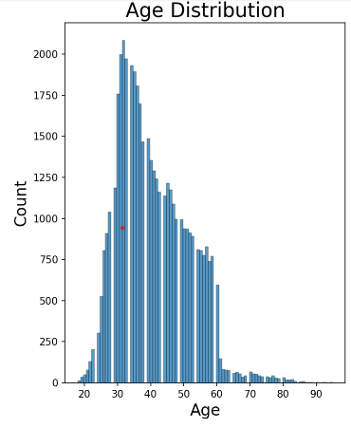
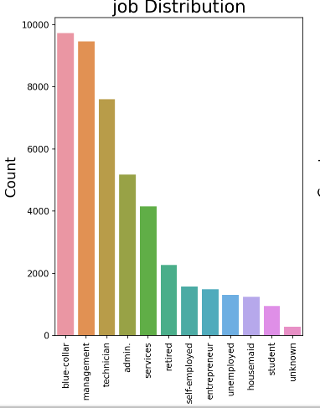
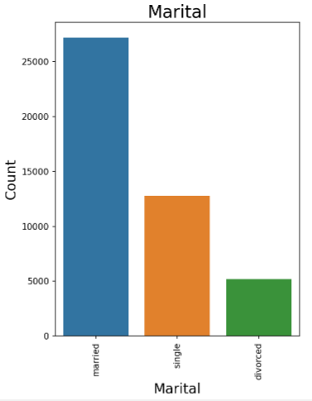
Important insights of EDA
Checked linear correlation between the features but we didn’t get any relationships between the data
Interpretations of feature distribution

Slide 4
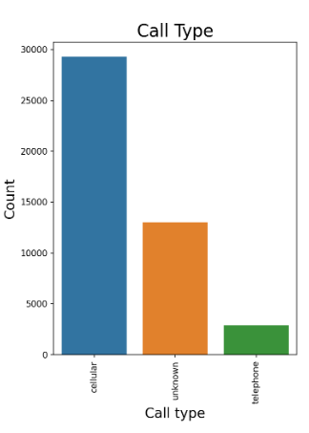
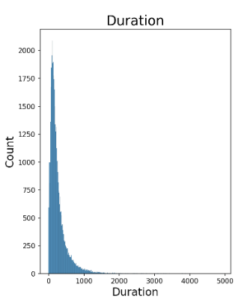
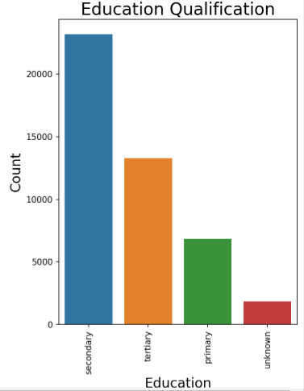
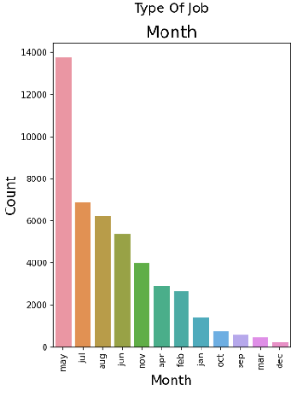
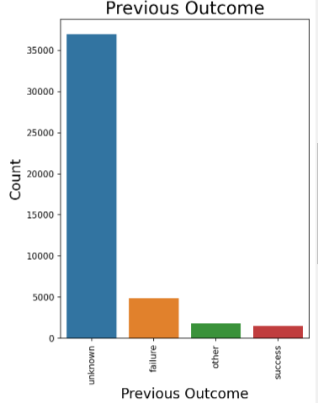
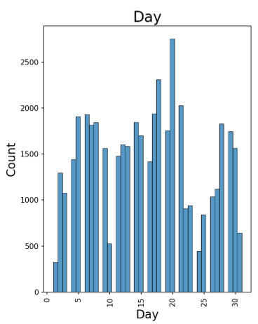
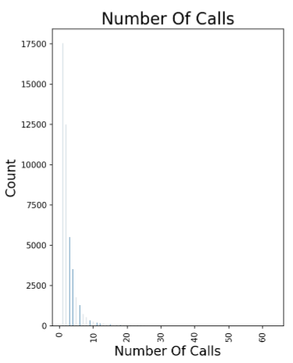

Slide 5
.AGE
Company targets 30 to 40 ages people to sell their insurance plan
People aged less than 25 years and more than 60 years are less targeted by the company for insurance
2. JOB
Blue collar and management people are targeted most by insurance company
Students are least targeted for insurance plan
3. MARITAL STATUS
Married people are targeted the most and divorced people are least targeted
4. EDUCATIONAL QUALIFICATION
Secondary qualified people have been targeted thye most for insurance followed by tertiary and primary
5. CALL_TYPE
Cellur mode is most used for contacting the people for campaign

Slide 6
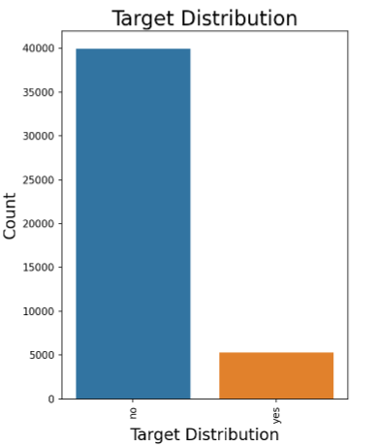
6. Month
May month is when maxmium calls are generated for new insurance customers,december is the least no of calls placed by the company
7. Duration
Maximum number of calls lasted less than 1000 seconds
8. Previous Outcome
More unknown as status than failure and success
9. Day
Most number of calls are between in the mid of month
10. Number of Calls
Most People are contacted only 1 or 2 times by the company
11. Target
No of people subscribed is very less compared to Unsubscribed people

Slide 7
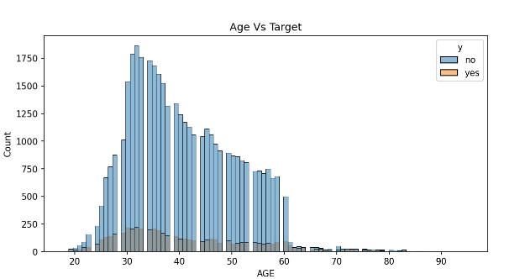
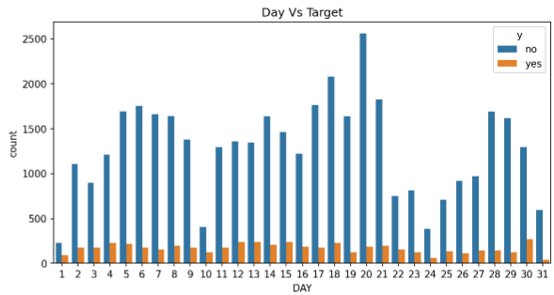
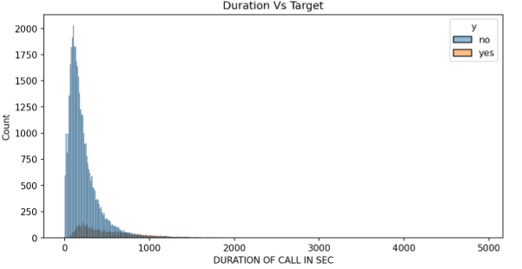
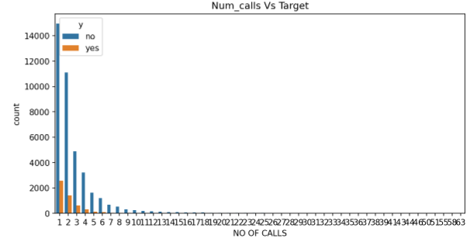
EDA on feature vs Target

Slide 8
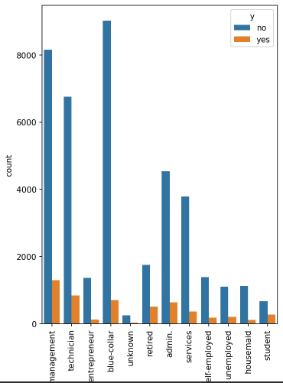
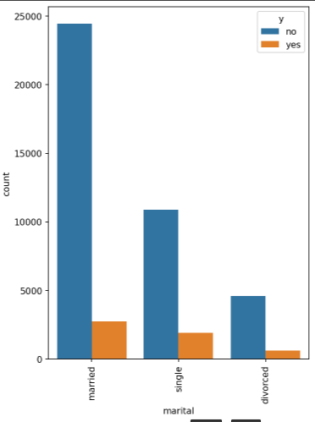
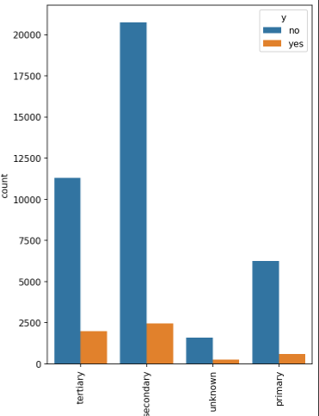
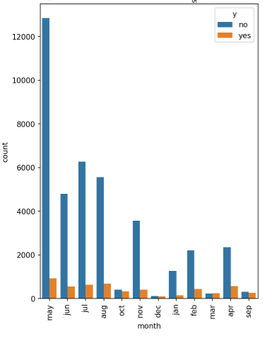
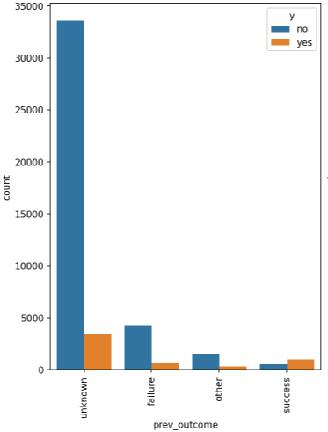
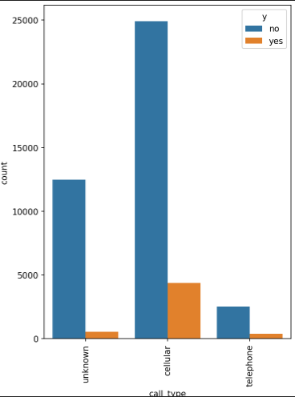

Slide 9
Built Models
We Encode our data by Label and One-hot encoding
We scaled our data by standard scalar and Split our data
We imported SMOTETomek module from imblearn.combine to balance our trained data
We built Logistic regression , KNN, Decision Tree, Random Forest, XG Boost
With all the features we got AUROC score of 0.77
From the feature selector we found age,education qualification, duration , day, month to have high feature importance and model was built on these features
We got a 0.79 AUROC Score, by Random Forest. So we can consider Random Forest is best suitable model

